Slide 1
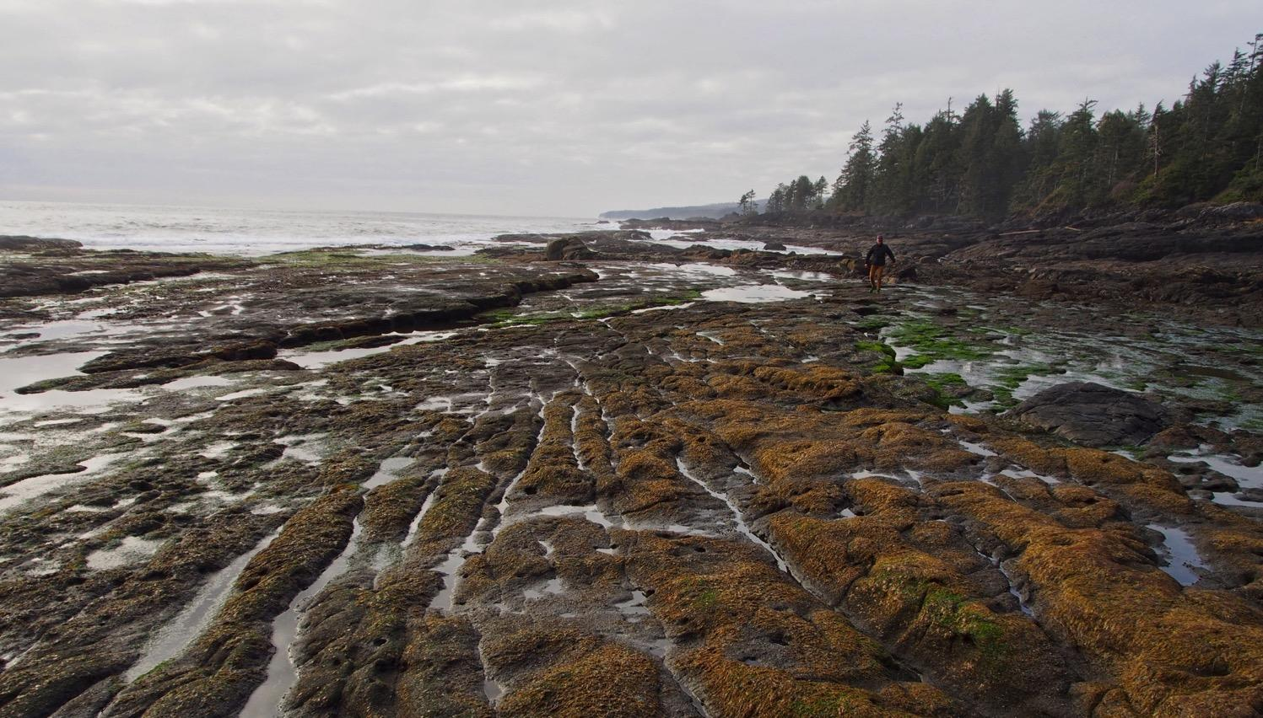

Learning and Teaching the SDGs
Working towards our Sustainable Development Goals
Notes:
Canada- https://un75.online/partner/UVIC China- https://cn.un75.online/?partner=UVIC

Slide 2

The Sustainable Development Goals (SDGs), also known as the Global Goals, were adopted by the United Nations in 2015 as a universal call to action to end poverty, protect the planet, and ensure that by 2030 all people enjoy peace and prosperity.
Notes:
Sustainability is most often defined as meeting the needs of the present without compromising the ability of future generations to meet theirs. It has three main pillars: economic, environmental, and social. These three pillars are informally referred to as people, planet and profits.
193 countries have officially adopted the SDGs
At its core, the 2030 Agenda includes 17 Sustainable Development Goals (SDGs) comprising 169 targets to be achieved by 2030.
Implicit in the SDGs logic is that the goals, and targets, relate to and depend on each other
Decade of action

Slide 3
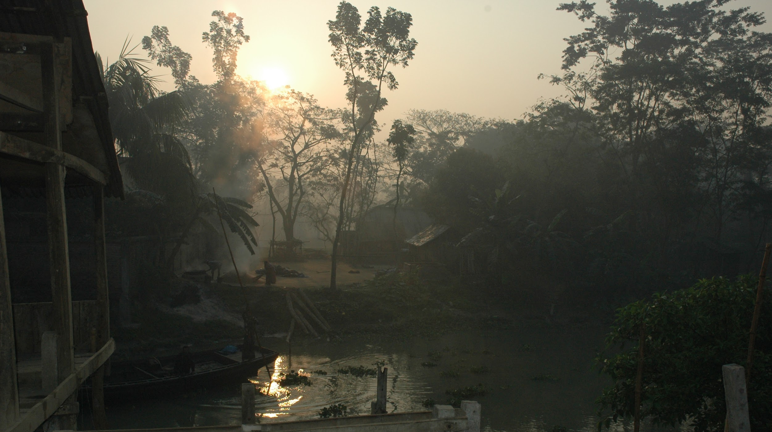
UN Sustainable Development Goals - Transforming our world:
the 2030 Agenda for Sustainable Development
This Agenda is a plan of action for people, planet and prosperity.
They are integrated and indivisible and balance the three dimensions of sustainable development: the economic, social and environmental.

Slide 4
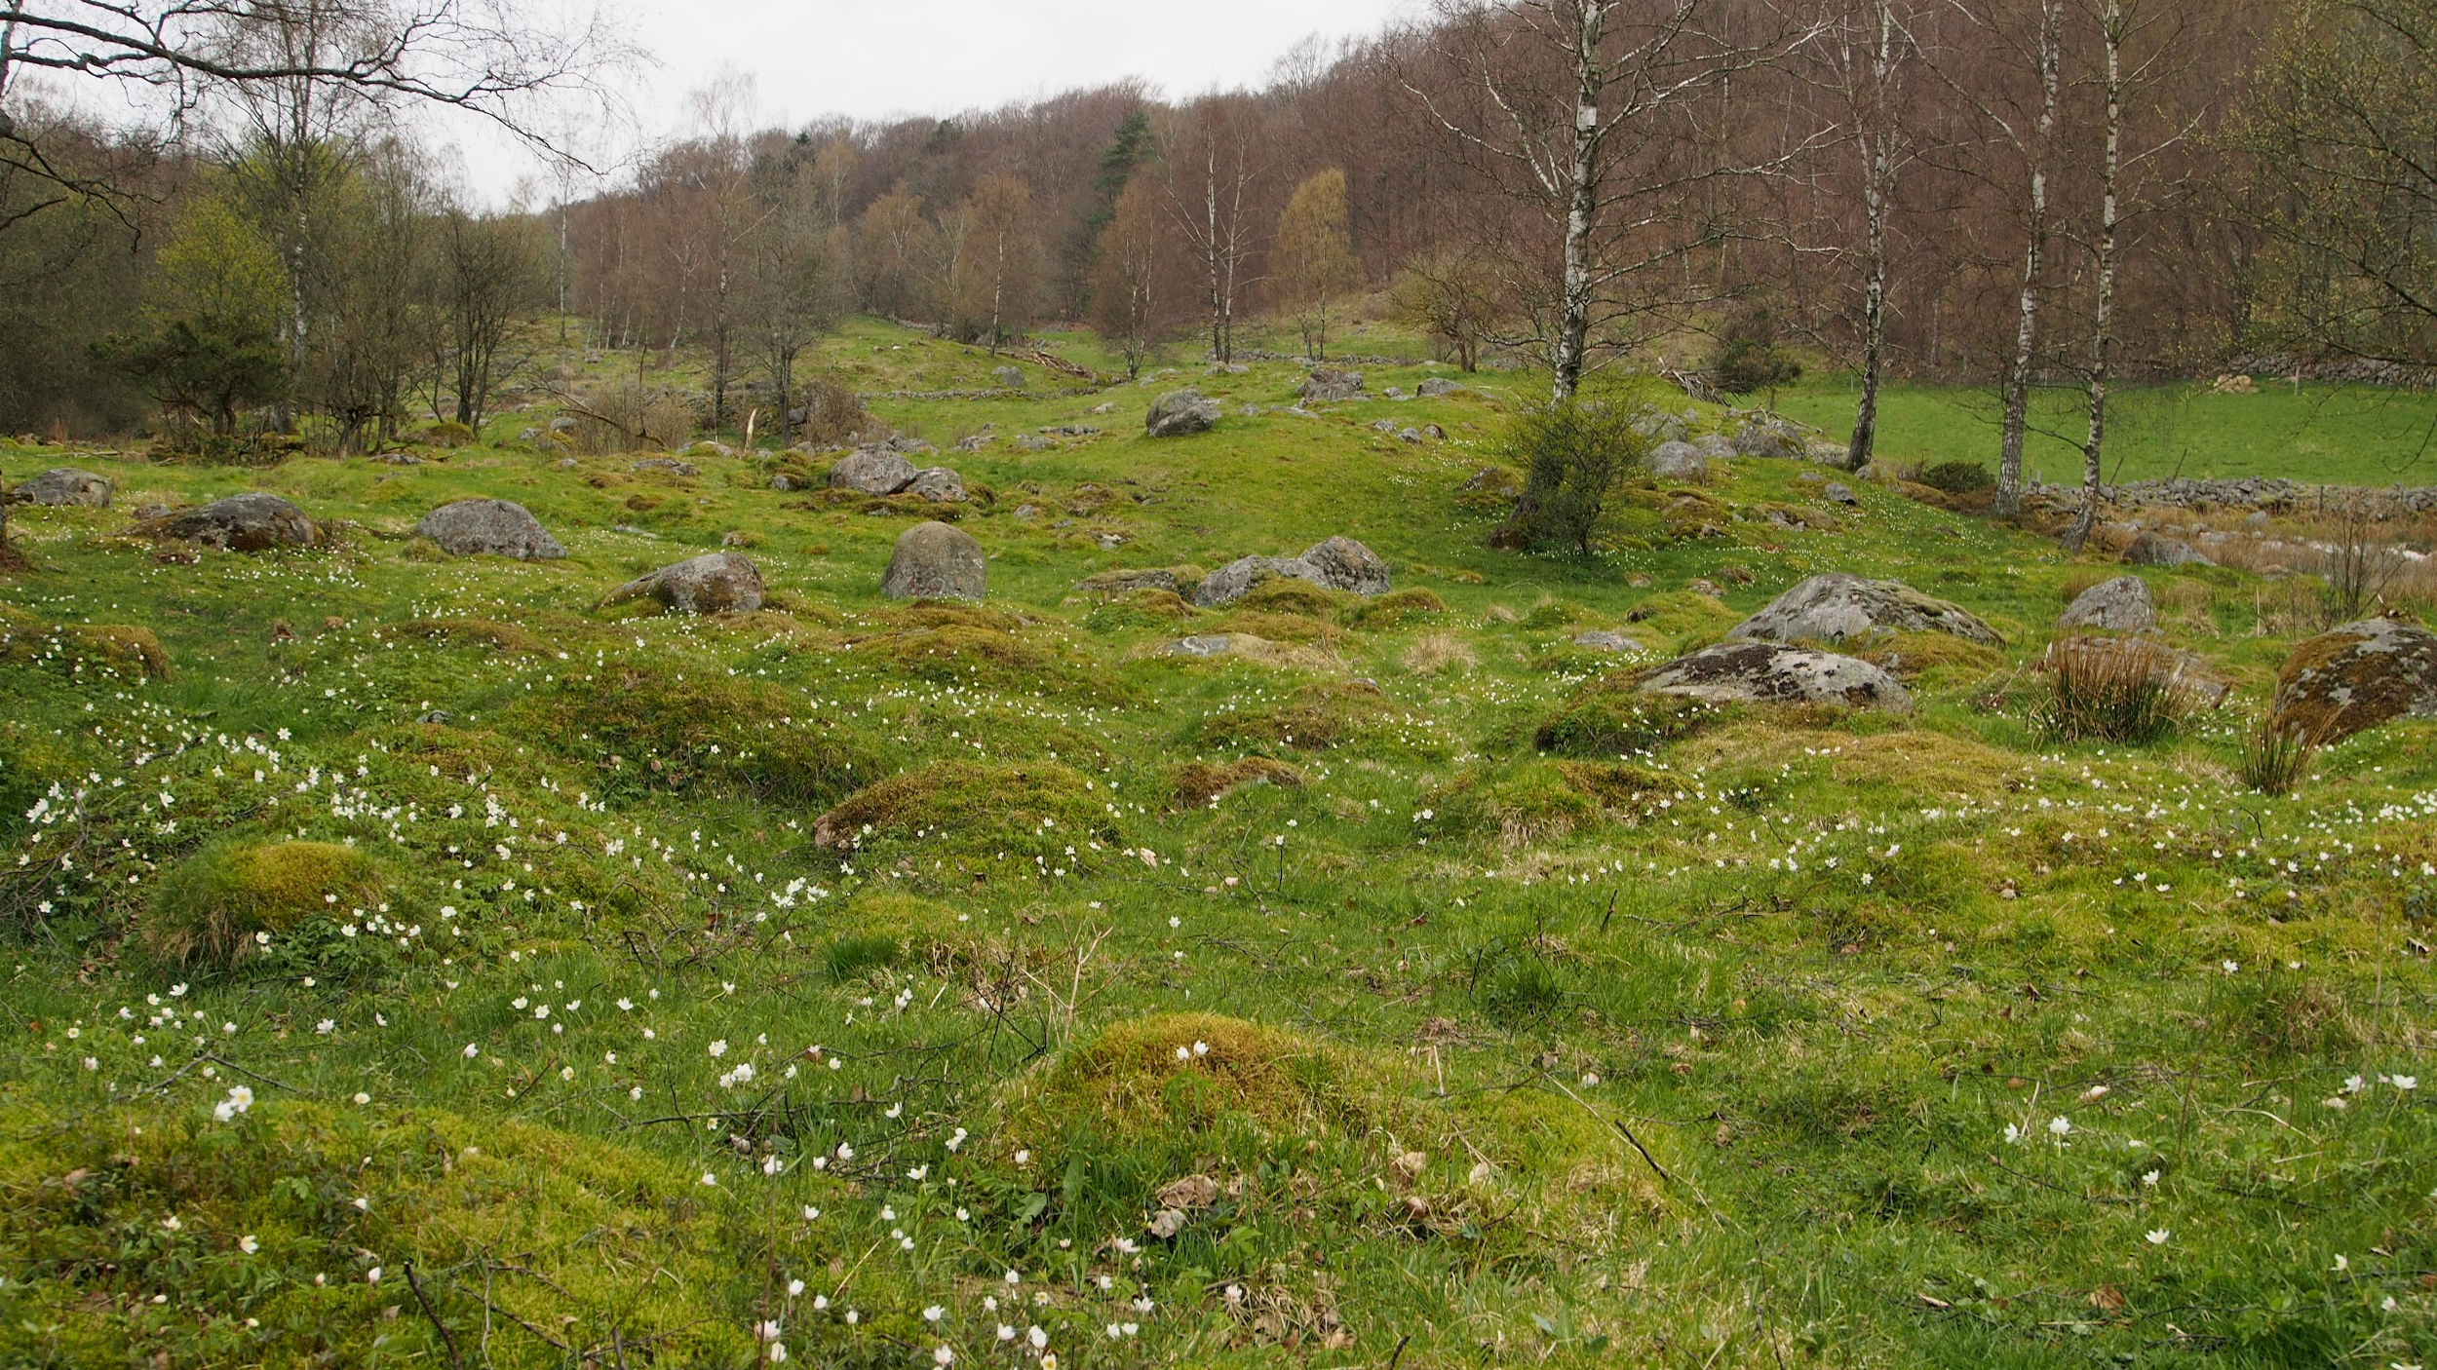

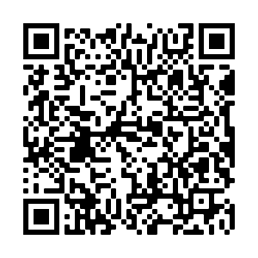
Locally contextualized knowledge co-creation - no one size fits all
Lived experience just as important as metrics (multiple types of knowledge systems)
Equitable access is paramount
Inclusion and community capacity building
UN DRIP and Indigenous wellbeing must be woven throughout
The UNSDGs
a pathway to achieving Agenda 2030
Download the UNDRIP booklet as a PDF

Slide 5
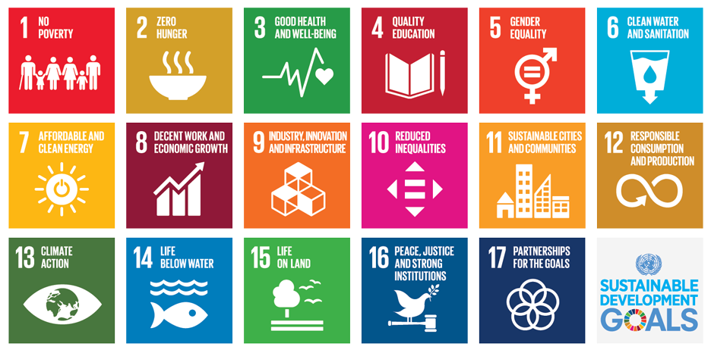
Annotate: Which SDGs most resonate with the
community/work experiences you support students with?

Slide 6
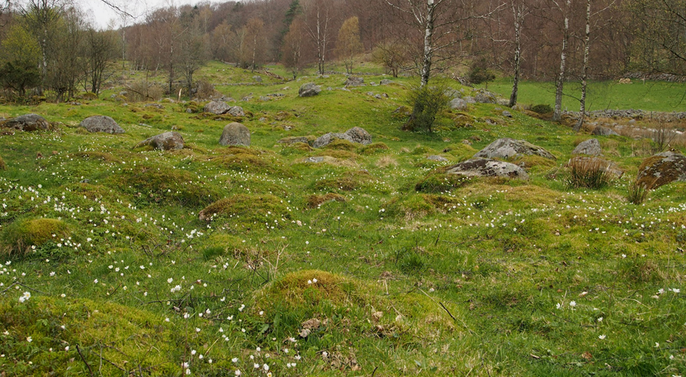
Which goal would you like to explore further with your colleagues right now?

Slide 7
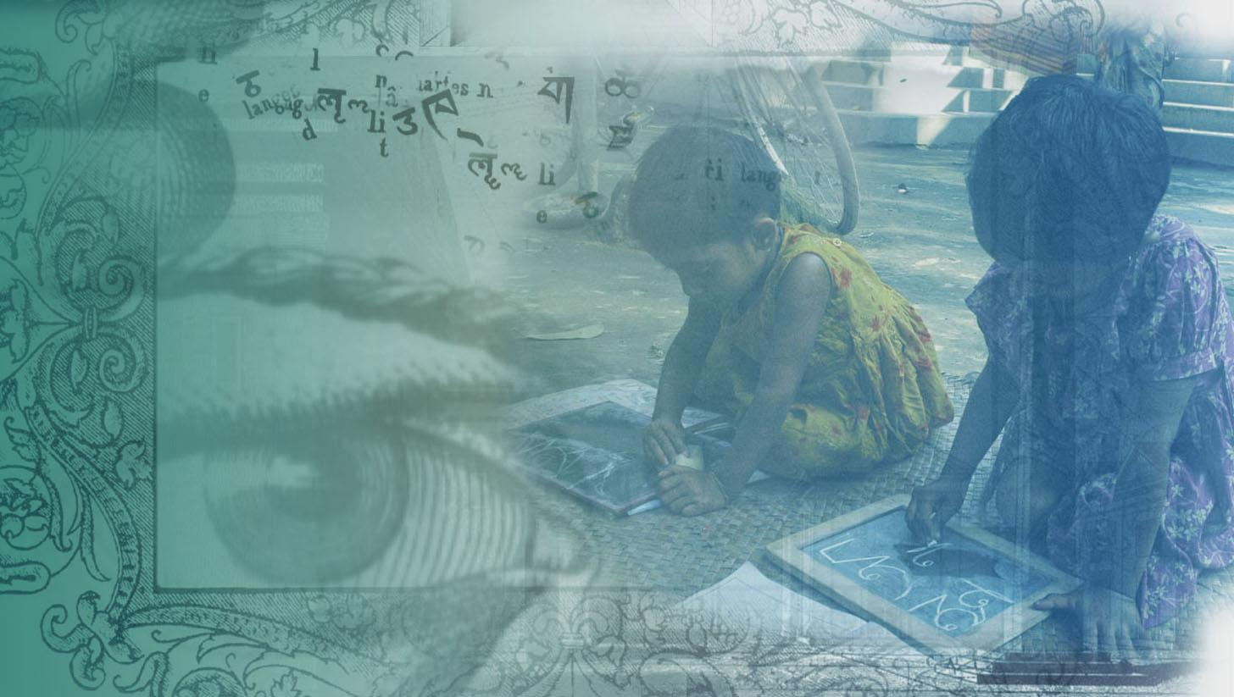
JigSaw activity about the SDG and/or its targets
1 thing that surprises you
1 question you have
1 thing you don’t understand or agree with
How would you fine-tune this goal and/or targets to make it more relevant for your local experience?
Review the link on your own and draft some quick responses to these questions/prompts
Discuss with your breakout group
Notes:
Be specific. We welcome concrete proposals and constructive criticism

Slide 8

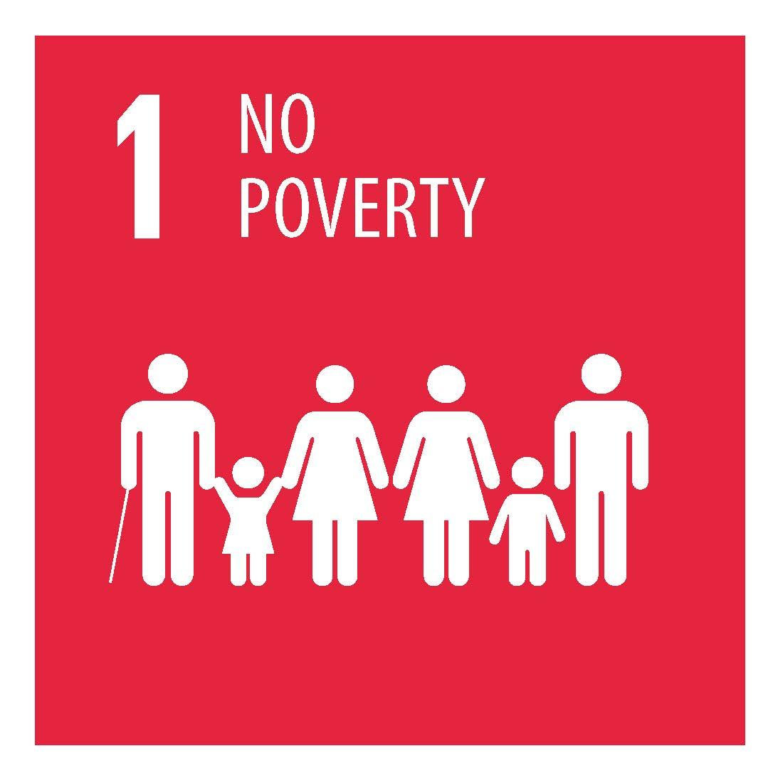
Goal 1 - No Poverty - end poverty in all it’s forms everywhere
calls for an end to poverty in all its manifestations by 2030. It also aims to ensure social protection for the poor and vulnerable, increase access to basic services and support people harmed by climate-related extreme events and other economic, social and environmental shocks and disasters.
https://www.un.org/sustainabledevelopment/poverty/

Slide 9

Goal 2 - Zero Hunger - End hunger, achieve food security and improved nutrition and promote sustainable agriculture
aims to end hunger and all forms of malnutrition by 2030. It also commits to universal access to safe, nutritious and sufficient food at all times of the year. This will require sustainable food production systems and resilient agricultural practices, equal access to land, technology and markets and international cooperation on investments in infrastructure and technology to boost agricultural productivity.
https://www.un.org/sustainabledevelopment/hunger/
?

Slide 10
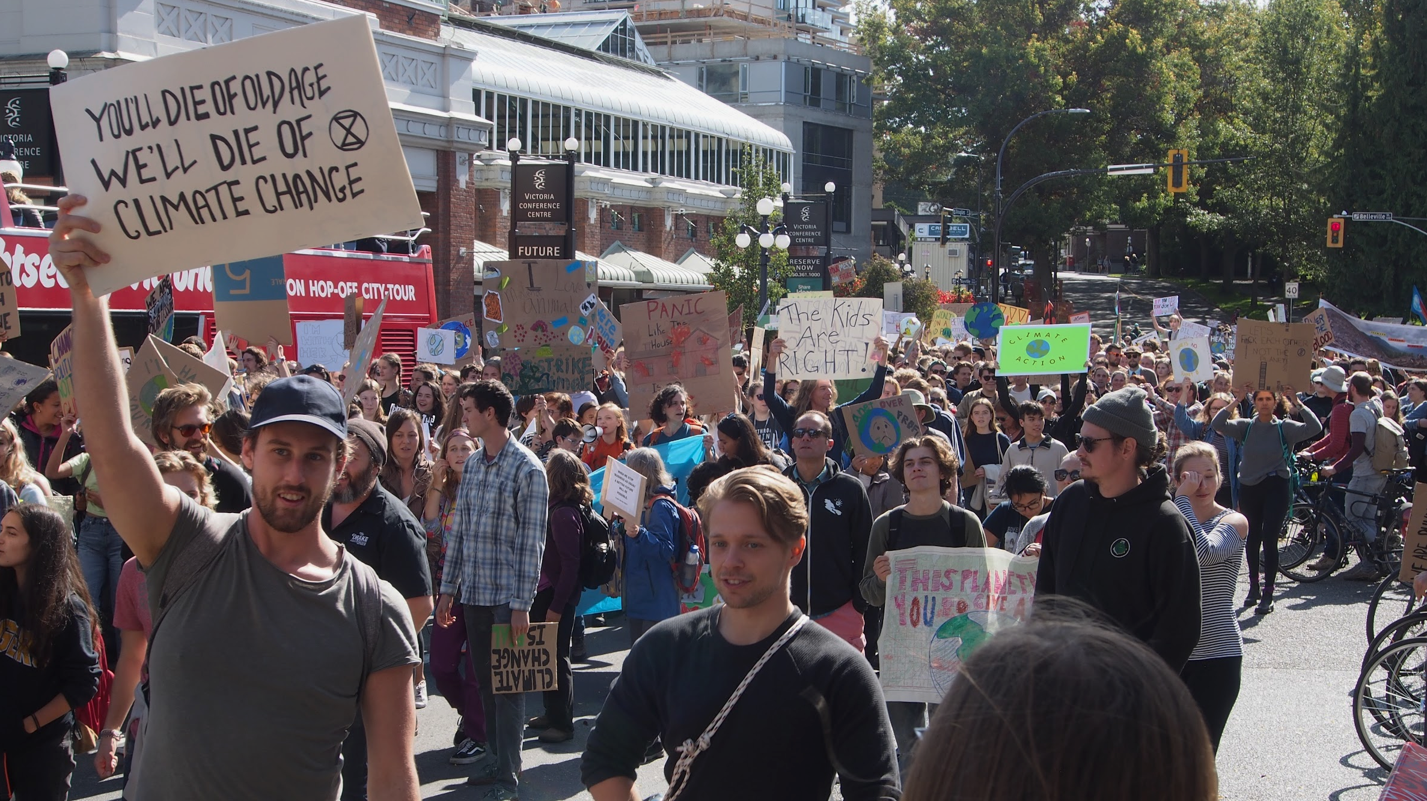

Goal 3 - Good Health and Well-being - Ensure healthy lives and promote well-being for all at all ages
seeks to ensure health and well-being for all, at every stage of life. The Goal addresses all major health priorities, including reproductive, maternal and child health; communicable, non-communicable and environmental diseases; universal health coverage; and access for all to safe, effective, quality and affordable medicines and vaccines. It also calls for more research and development, increased health financing, and strengthened capacity of all countries in health risk reduction and management.
https://www.un.org/sustainabledevelopment/health/

Slide 11

Goal 4 - Quality Education - Ensure inclusive and equitable quality education and promote lifelong learning opportunities for all
Despite progress, the world failed to meet the Millennium Development Goal of achieving universal primary education by 2015. In 2013, the latest year for which data are available, 59 million children of primary-school age were out of school. Estimates show that, among those 59 million children, 1 in 5 of those children had dropped out and recent trends suggest that 2 in 5 of out-of-school children will never set foot in a classroom. The Sustainable Development Goals clearly recognize that this gap must be closed, even as the international community more explicitly addresses the challenges of quality and equity.
https://www.un.org/sustainabledevelopment/education/
Notes:
Be specific. We welcome concrete proposals and constructive criticism

Slide 12

Goal 5 - Gender Equality - Achieve gender equality and empower all women and girls
Gender equality and women’s empowerment have advanced in recent decades. Girls’ access to education has improved, the rate of child marriage declined and progress was made in the area of sexual and reproductive health and reproductive rights, including fewer maternal deaths. Nevertheless, gender equality remains a persistent challenge for countries worldwide and the lack of such equality is a major obstacle to sustainable development.
https://www.un.org/sustainabledevelopment/gender-equality/

Slide 13

Goal 6 - Clean Water and Sanitation -Ensure availability and sustainable management of water and sanitation for all
Water and sanitation are at the very core of sustainable development, critical to the survival of people and the planet. Goal 6 not only addresses the issues relating to drinking water, sanitation and hygiene, but also the quality and sustainability of water resources worldwide.
https://www.un.org/sustainabledevelopment/water-and-sanitation/
Notes:
Each participant places a sticker from each category along the gradient from worse to better. Use callout notes to document why.

Slide 14

Goal 7 - Affordable and Clean Energy - Ensure access to affordable, reliable, sustainable and modern energy for all
Energy is crucial for achieving almost all of the Sustainable Development Goals, from its role in the eradication of poverty through advancements in health, education, water supply and industrialization, to combating climate change.
https://www.un.org/sustainabledevelopment/energy/
?

Slide 15

Goal 8 - Decent Work and Economic Growth - Promote sustained, inclusive and sustainable economic growth, full and productive employment and decent work for all
Sustained and inclusive economic growth is necessary for achieving sustainable development.
https://www.un.org/sustainabledevelopment/economic-growth/

Slide 16

Goal 9 - Industry, Innovationand Infrastructure - Build resilient infrastructure, promote inclusive and sustainable industrialization and foster innovation
encompasses three important aspects of sustainable development: infrastructure, industrialization and innovation. Infrastructure provides the basic physical systems and structures essential to the operation of a society or enterprise. Industrialization drives economic growth, creates job opportunities and thereby reduces income poverty. Innovation advances the technological capabilities of industrial sectors and prompts the development of new skills.
https://www.un.org/sustainabledevelopment/infrastructure-industrialization/
Notes:
Be specific. We welcome concrete proposals and constructive criticism

Slide 17

Goal 10 - Reduce Inequalities - Reduce inequality within and among countries
calls for reducing inequalities in income as well as those based on age, sex, disability, race, ethnicity, origin, religion or economic or other status within a country. The Goal also addresses inequalities among countries, including those related to representation, migration and development assistance.
https://www.un.org/sustainabledevelopment/inequality/

Slide 18

Goal 11 - Sustainable Cities and Communities - Make cities and human settlements inclusive, safe, resilient and sustainable
Despite numerous planning challenges, well-managed cities and other human settlements can be incubators for innovation and ingenuity and key drivers of sustainable development.
https://www.un.org/sustainabledevelopment/cities/
Notes:
Each participant places a sticker from each category along the gradient from worse to better. Use callout notes to document why.

Slide 19

Goal 12 - Responsible Consumption and Production - Ensure sustainable consumption and production patterns
Economic growth and development require the production of goods and services that improve the quality of life. Sustainable growth and development require minimizing the natural resources and toxic materials used, and the waste and pollutants generated, throughout the entire production and consumption process.
https://www.un.org/sustainabledevelopment/sustainable-consumption-production/
?

Slide 20

Goal 13 - Climate Action - Take urgent action to combat climate change and its impacts
Climate change presents the single biggest threat to development, and its widespread, unprecedented impacts disproportionately burden the poorest and most vulnerable. Urgent action to combat climate change and minimize its disruptions is integral to the successful implementation of the Sustainable Development Goals.
https://www.un.org/sustainabledevelopment/climate-change/

Slide 21

Goal 14 - Life Below Water - Conserve and sustainably use the oceans, seas and marine resources for sustainable development
Oceans, along with coastal and marine resources, play an essential role in human well-being and social and economic development worldwide. They are particularly crucial for people living in coastal communities, who represented 37 per cent of the global population in 2010. Oceans provide livelihoods and tourism benefits, as well as subsistence and income. They also help regulate the global ecosystem by absorbing heat and carbon dioxide from the atmosphere and protecting coastal areas from flooding and erosion.
https://www.un.org/sustainabledevelopment/oceans/
Notes:
Be specific. We welcome concrete proposals and constructive criticism

Slide 22

Goal 15 - Life on Land - Protect, restore and promote sustainable use of terrestrial ecosystems, sustainably manage forests, combat desertification, and halt and reverse land degradation and halt biodiversity loss
Preserving diverse forms of life on land requires targeted efforts to protect, restore and promote the conservation and sustainable use of terrestrial and other ecosystems. Goal 15 focuses specifically on managing forests sustainably, restoring degraded lands and successfully combating desertification, reducing degraded natural habitats and ending biodiversity loss.
https://www.un.org/sustainabledevelopment/biodiversity/

Slide 23

Goal 16 - Peace, Justice and Strong Institutions - Promote peaceful and inclusive societies for sustainable development, provide access to justice for all and build effective, accountable and inclusive institutions at all levels
Peace, justice and effective, accountable and inclusive institutions are at the core of sustainable development. Several regions have enjoyed increased and sustained levels of peace and security in recent decades. But many countries still face protracted armed conflict and violence, and far too many people struggle as a result of weak institutions and the lack of access to justice, information and other fundamental freedoms.
https://www.un.org/sustainabledevelopment/peace-justice/
Notes:
Each participant places a sticker from each category along the gradient from worse to better. Use callout notes to document why.

Slide 24

Goal 17 - Partnerships for the Goals - Strengthen the means of implementation and revitalize the global partnership for sustainable development
Achieving the ambitious targets of the 2030 Agenda requires a revitalized and enhanced global partnership that brings together Governments, civil society, the private sector, the United Nations system and other actors and mobilizes all available resources. Enhancing support to developing countries, in particular the least developed countries and the small island developing States, is fundamental to equitable progress for all.
https://www.un.org/sustainabledevelopment/globalpartnerships/
?

Slide 25
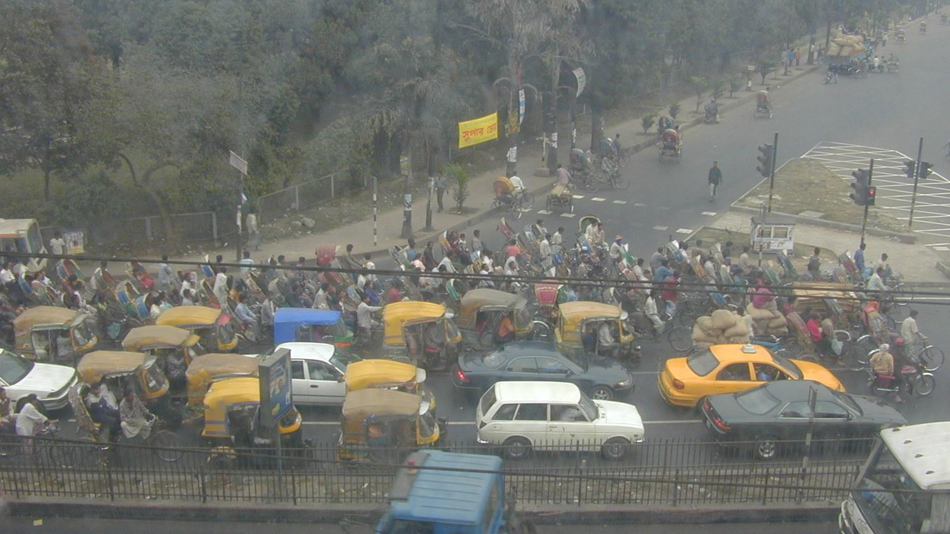

SDGs and the way we teach and support students, community and employers
Intended Learning Outcomes
Learning content
Learning activities
Learning materials
Assignments and assessment
Class atmosphere and well-being
Notes:
Use the UNSDGs as a prompt to identify priorities. Save those goals that are thought to be a lower priority right now in the cupped hands. Use sticky notes to document the discussion around the priorities identified.

Slide 26
SDGs and the way we teach and support students, community and employers
Support reflection on practice
Foster learning about the SDGs
Relate experiences to the other SDGs and UNDRIP
Notes:
Use the UNSDGs as a prompt to identify priorities. Save those goals that are thought to be a lower priority right now in the cupped hands. Use sticky notes to document the discussion around the priorities identified.

Slide 27
SDGs and the way we teach and support students, community and employers
“Pick” a card and speak to how you could incorporate or further incorporate that SDG into your WIL work
In relation to the SDG on the card that remains in the pile, speak to how what you describe supports, hinders or is neutral to SDG and/or UNDRIP
Notes:
Use the UNSDGs as a prompt to identify priorities. Save those goals that are thought to be a lower priority right now in the cupped hands. Use sticky notes to document the discussion around the priorities identified.

